Slide 1
Threat Signals: Cybercrime Patterns Across Asia (2021-24)
Name : Aryan Padumale
Student ID: AF05309804
Notes:
Srtjsrgtmnsa w45yaer5yh e

Slide 2
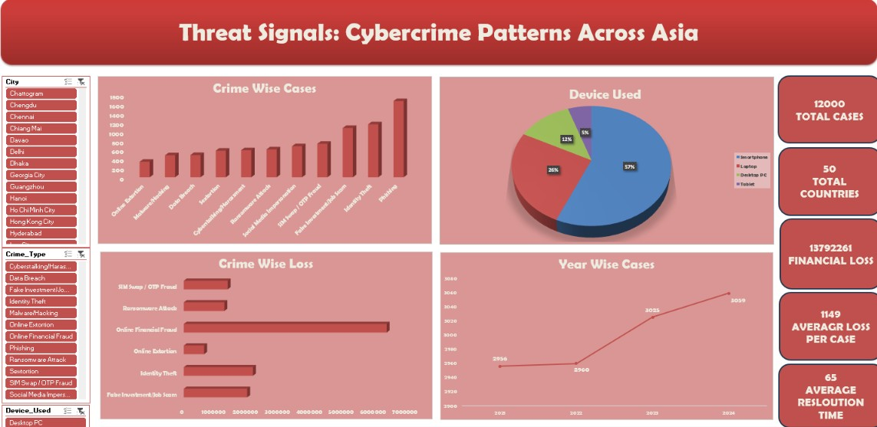

Slide 3
Project Workflow
📚
Raw Dataset
⚒️
Data Cleaning
📰
Data Preparation
💡
Insights
🖥️
Dashboard
📜
Charts
📑
Pivot Tables

Slide 4
Key Findings
12000
TOTAL CASES
50
TOTAL COUNTRIES
13792261
FINANCIAL LOSS
1149
AVERAGR LOSS PER CASE
0.3445
CASES UNDER INVESTIGATIN
65
AVERAGE RESLOUTION TIME

Slide 5

Crime Patterns And Attack Methods
Phishing and identity theft are among the most common cybercrime cases shown in the data.
Smartphones are the most commonly used devices, followed by laptops and desktop PCs.

Slide 6
Trends Over Time
Cybercrime cases show an overall increasing trend from 2021 to 2024, rising from 2,956 to 3,059 cases.

Slide 7
Conclusion
India and China lead in case volume; the 26–35 age group is most targeted.
34.4% of cases remain unresolved — highlighting a regional investigation backlog.
Financial fraud dominates, driven mainly by smartphone-based attacks.

Slide 8
Thank You

